Slide 1

ITI
Introduction to Computer Networks & Cyber Security

Slide 2
References
Essential Computer Science “ Paul D. Crutcher,Neeraj Kumar Singh,Peter Tiegs”
Cisco Student Guide ICND1
CompTIA Network
Data and Computer Communications “ William Stallings 10th Edition”
TCP/IP Protocol Suite “Behrouz A. Forouzan 4th Edition”
Understanding IPv6 “Joseph Davies 2nd Edition”
Distributed Systems ”van Steen, Maarten, Tanenbaum, Andrew S.”

Slide 3
Course Duration and Assessment
Duration
Lectures: 7
Labs: 2
Assessment
Final Exam : 70%
Assignments : 10 %
Labs : 20 %

Slide 4
Agenda
Part 1
Network Essentials
Part 2
Cyber Security Essentials
Part 3
Distributed Systems

Slide 5
Part 1 (Network Essentials)
Course Outlines Computer Networks
Definition and Basic Terminologies
OSI Model
TCP/IP Protocol Suite
Network Access Layer (Physical Layer /Datalink Layer)
Internet layer
Transport layer
Application Layer
Network Devices
Network Media

Slide 6
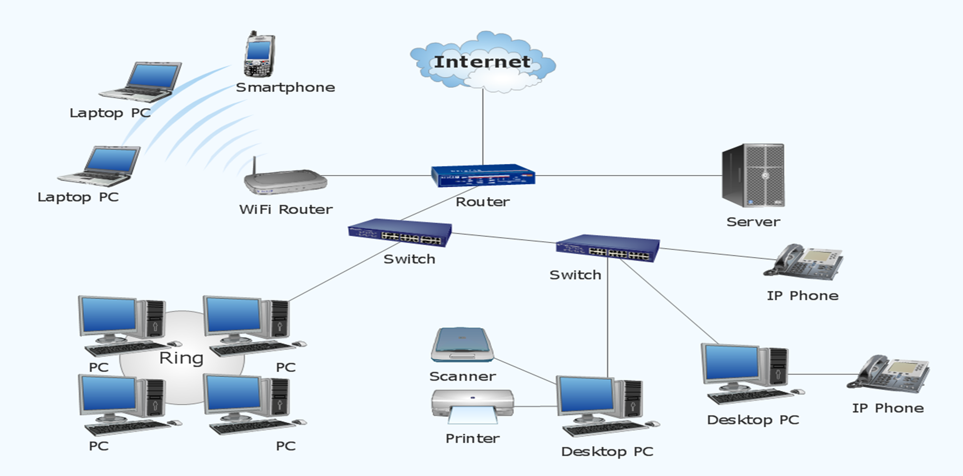
Part 1 (Computer Networks Definition)
Computer Network :
a collection of computers, and other devices, or peripherals connected together through connecting media to perform certain task such as : Share Resources
Resources can be :
File Sharing
Devices Sharing
Software Sharing with multi-user licenses.
Voice and Video calls
Shared Internet Access

Slide 7
Part1 (Network Elements)
Network Elements
Hardware
Devices
Computers – Printers –Phone – Routers - Switches
Medium
Wired -Wireless –Satellites
Software
Messages
Information that travels over the medium such as Mails-WhatsApp….etc
Protocols
Governs how messages flow across network such as http –https-FTP-RDP

Slide 8
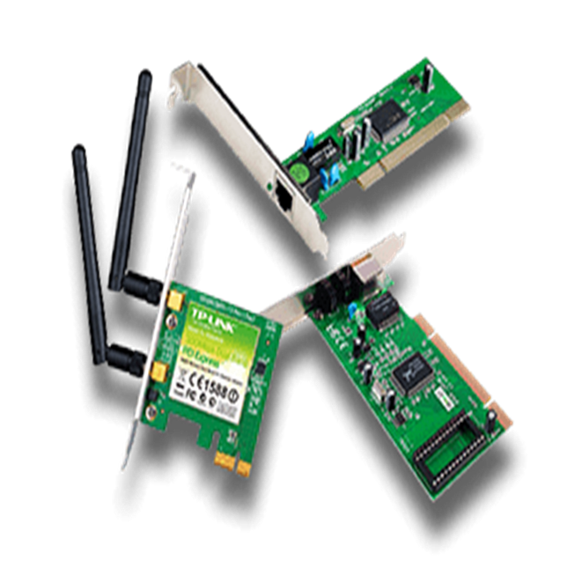
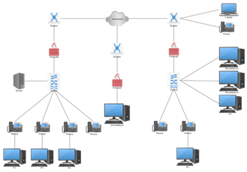
Session 1 (Network Basic Terminologies )
NIC (Network Interface Card)/network adapter or LAN adapter.
a hardware that enable the device to directly access the network
Internal NIC (plugs into the motherboard directly)
External NIC(Wireless and USB based )
Mac address:
Physical Address, Unique address over the world burned on the NIC card
IP address :
logical address, identify each device on an IP network layer.
Protocols
Communication rules that all entity must agree on http –https-FTP-RDP
Topology
how devices are connected (shape) and how message flow from one device to another device

Slide 9
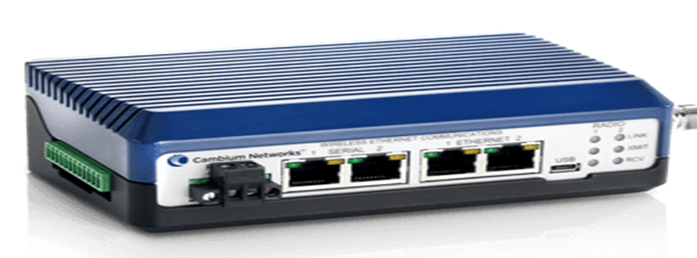
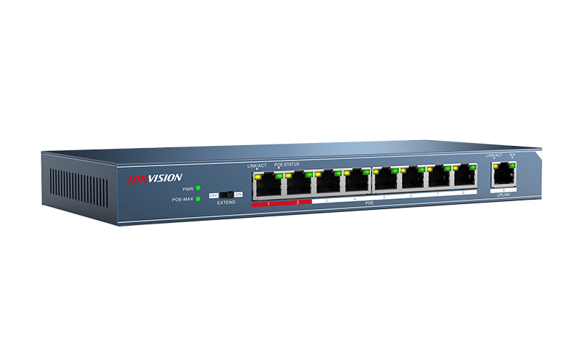
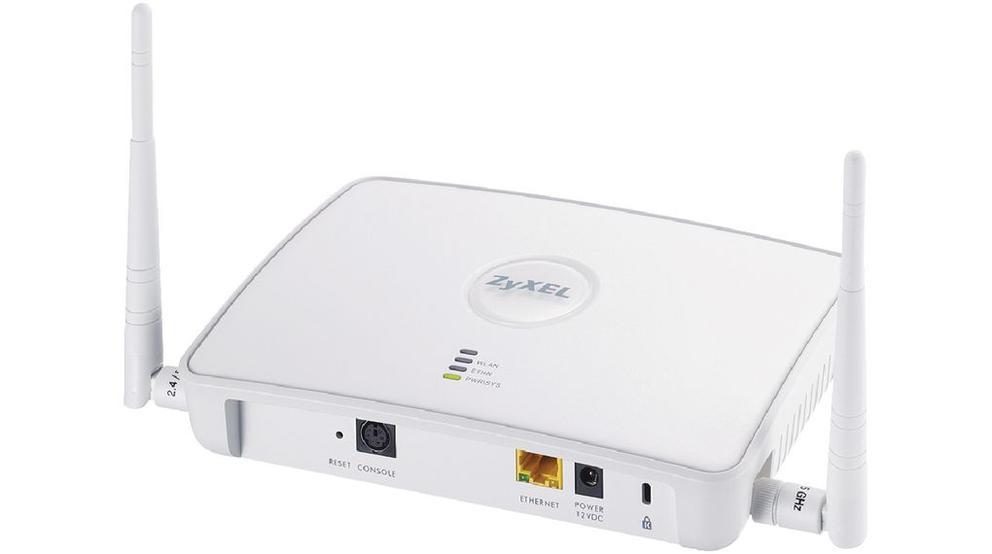
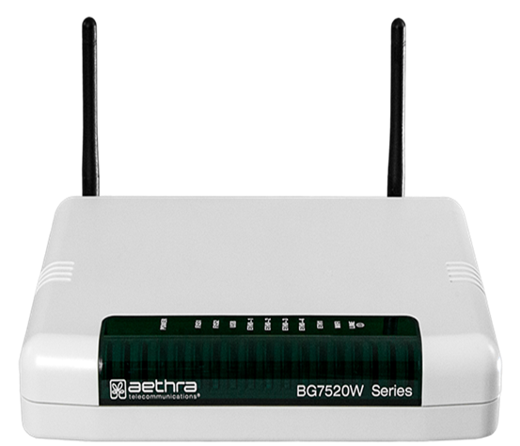
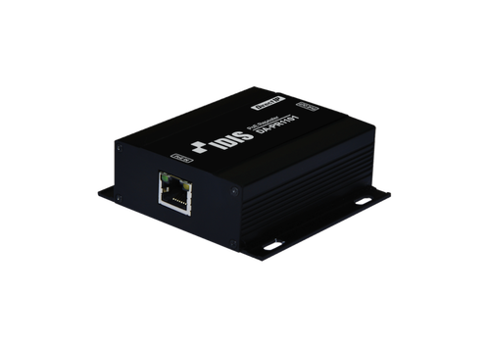
Session 1 (Network Basic Terminologies )
Hub
Allow different nodes to communicate with each other at the same network(Slow the network)
Switch
Allow different nodes to communicate with each other at the same network and time without slowing each other
Router
Allow different networks to communicate with each other
Access point (AP)
allows other Wi-Fi devices to connect to a wired network. An AP is a physical location where Wi-Fi access is available.
Repeater
Regenerate the signal over the same network before the signal becomes too weak or corrupted

Slide 10
How to apply networks ?
According to Covered Area
How large is the network?
According to network topology
How the computer are connected?
According to network model
What type of model?

Slide 11
Networks Classifications
According to Covered Area
PAN – MAN- WAN-INTERNET

Slide 12
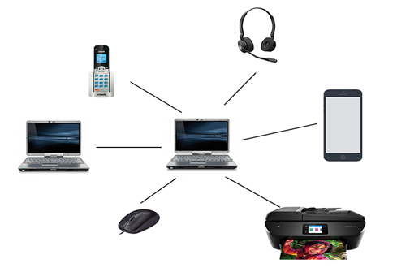
According to Covered Area
Personal Area Networks (PAN)
a computer network for interconnecting devices centered on an individual person's workspace.
A PAN provides data transmission among devices such as computers, smartphones, tablets and personal digital assistants

Slide 13
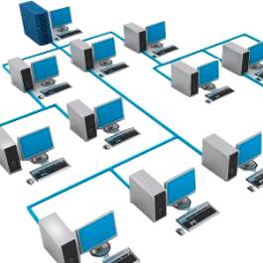
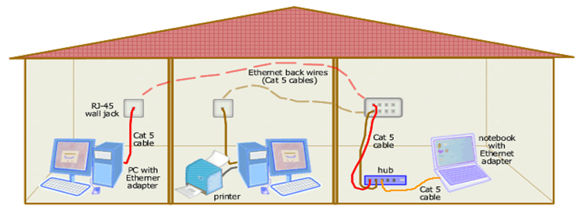
According to Covered Area
Local Area Networks (LAN)
a group of computers connected in small geographical area
a limited area such as a residence, school, laboratory, university campus or office building (100 -1000 M)
Allow users to share files and services
High speed of communications
Under your administrative Control

Slide 14
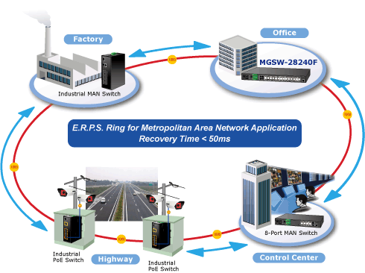
According to Covered Area
Metropolitan Area Networks (MAN)
A MAN connects an area larger than a LAN but smaller than a WAN (Up to 100 km)
such as a city.
dedicated or high-performance hardware

Slide 15
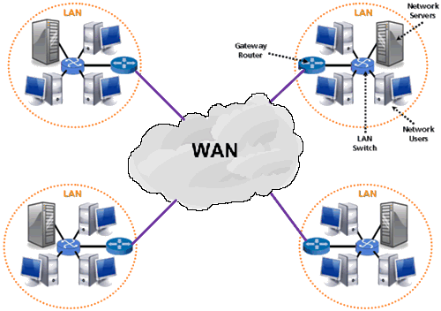
According to Covered Area
Wide Area Networks (WAN)
A WAN is a group of computers connected in Large geographical area such as country
A WAN often connects two LANs (WAN Link)
WAN can contain multiple smaller networks, such as LANs or MANs.
Very low Speed
Under your ISP Administrative control example of WAN is Internet

Slide 16
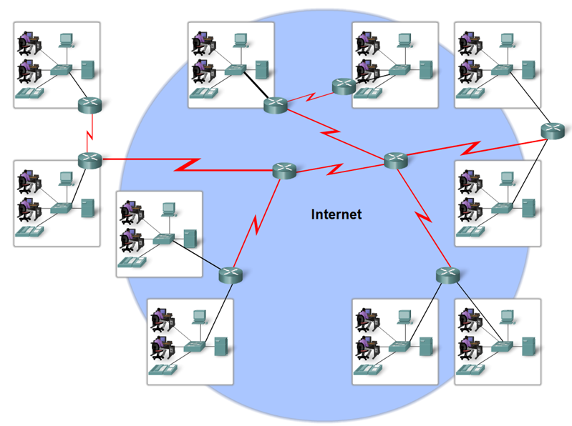
What is Internet ?
Internet (WWW)
The internet is defined as a global mesh of interconnected networks
the most used service on the Internet is the World Wide Web
No one actually owns the Internet
Many Orgs, ISPs, Companies, Govs own pieces of Internet Infrastructure.
ISOC: Internet Society
IETF: Internet Engineering Task Forum
ICANN: Internet Corporation for Assigned Names and Numbers

Slide 17
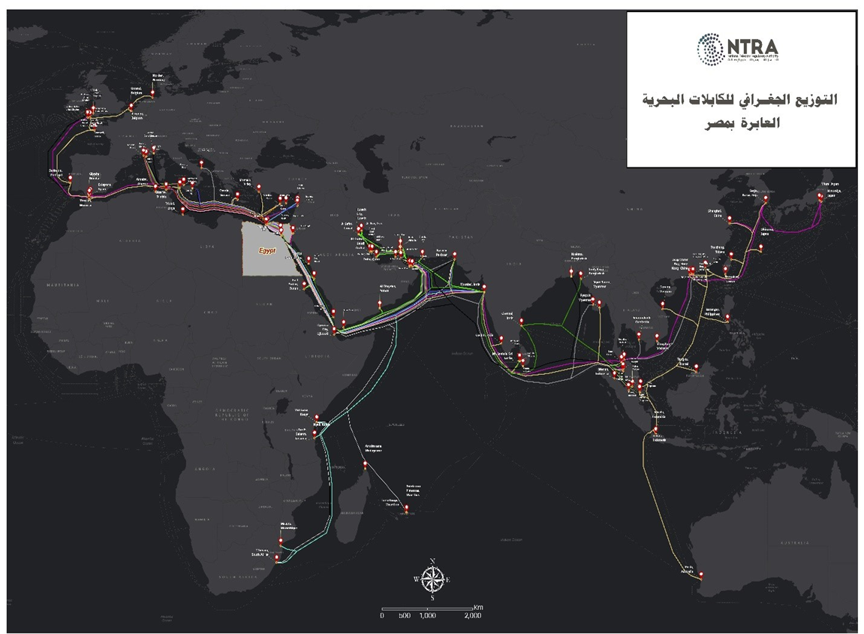
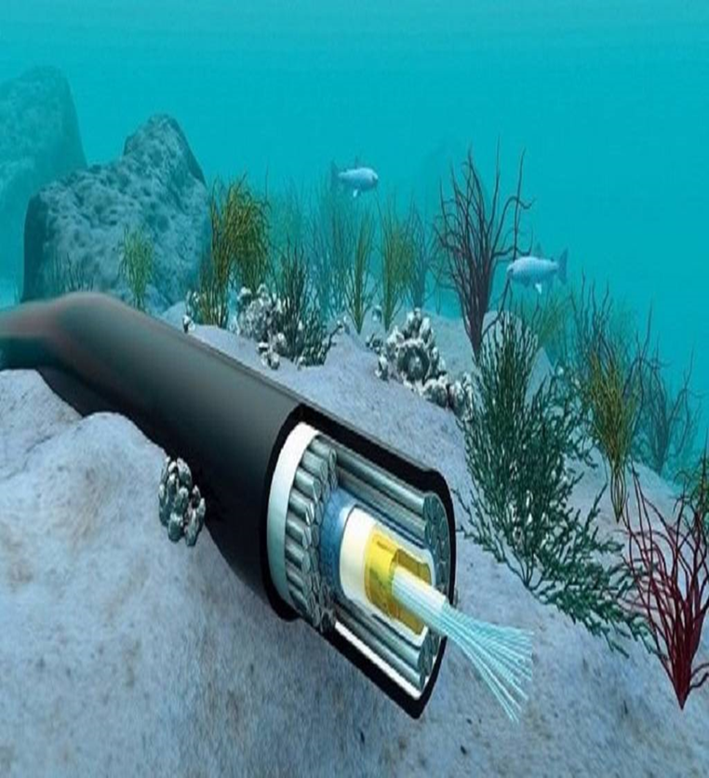
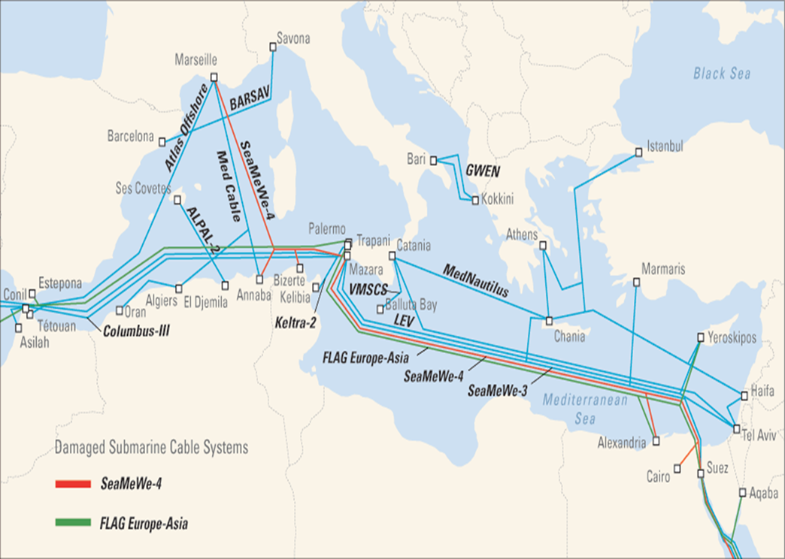
Internet Gateway in Egypt_ Submarine Cable

Slide 18
Networks Classifications
According to Network Topology
Bus – Star- Ring- Mesh-Hybrid

Slide 19
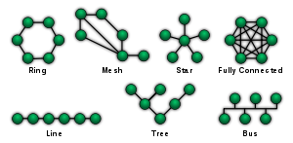
Network Topology
Topology
Refers to the shape of a network, or the network's layout.
Types
Physical Topology: how computers connected to each other physically (wired)
Logical Topology: how to send message from device to other, (the way in which to the generated signal actual path across the network).
Dependent on :
Type and number of equipment being used
Cost
Each topology has its own advantages and disadvantages.

Slide 20
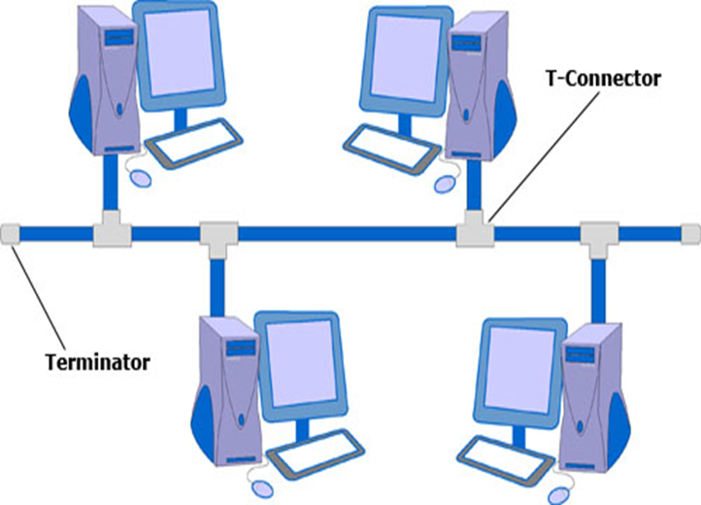
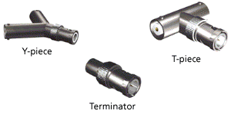
Network Topology
Bus Topology
All devices are connected to a central cable, called the bus or backbone
Both ends of the network must be terminated with a terminator.
A barrel connector can be used to extend the network.

Slide 21
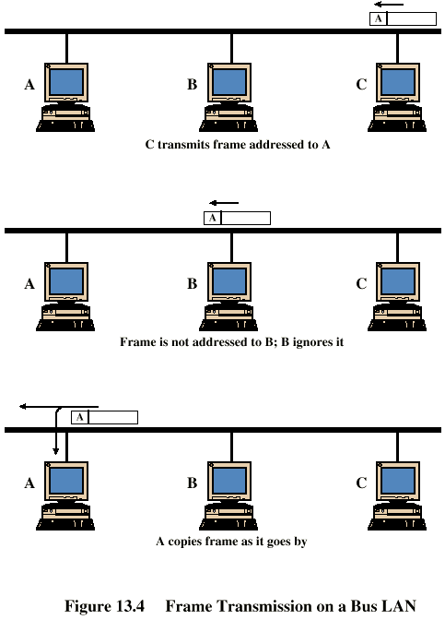
Network Topology
Frame Transmission - Bus LAN
The backbone functions as a shared communication medium
Device wanting to communicate with another device on the network sends a message onto the backbone
The message is heard by all stations, but only the intended recipient actually accepts and processes the message.
Terminator absorbs frames at end of medium
Station C want to transmit a frame of data to station A.

Slide 22
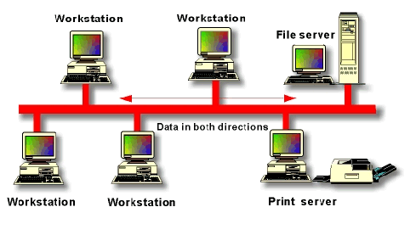
Network Topology
Bus Advantages and Disadvantages
Advantages
Simple, easy to use and construct
Requires least amount of cable (less expensive)
Reliable
Disadvantages
A faulty cable take the entire LAN down
Difficult to troubleshoot
No security
Slow during peak traffic period

Slide 23
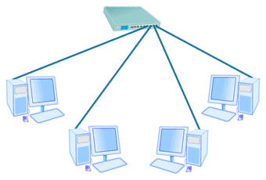
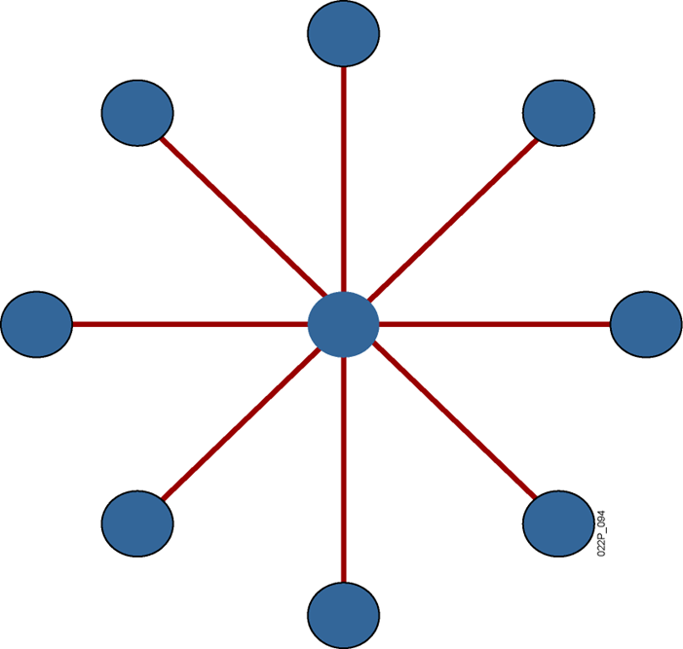
Network Topology
Star Topology
- All the devices are connected to a centralized unit such as a Hub or Switch.
- Nodes communicate across the network by passing data through the central device.

Slide 24
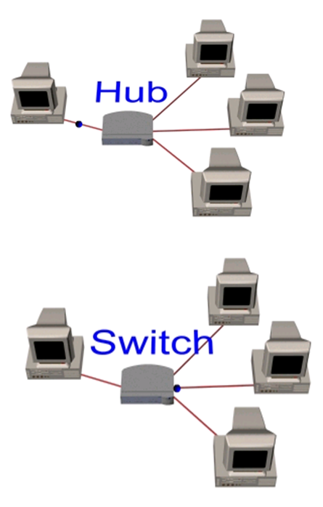
Network Topology
Star Topology types
Hubbed Star ( Broadcasted Star Topology)
Central node can broadcast (Hub)
- Physical star, logically bus
- Only one station can transmit at a time
Switched Star
Central node can act as frame switch
- Retransmits only to destination

Slide 25
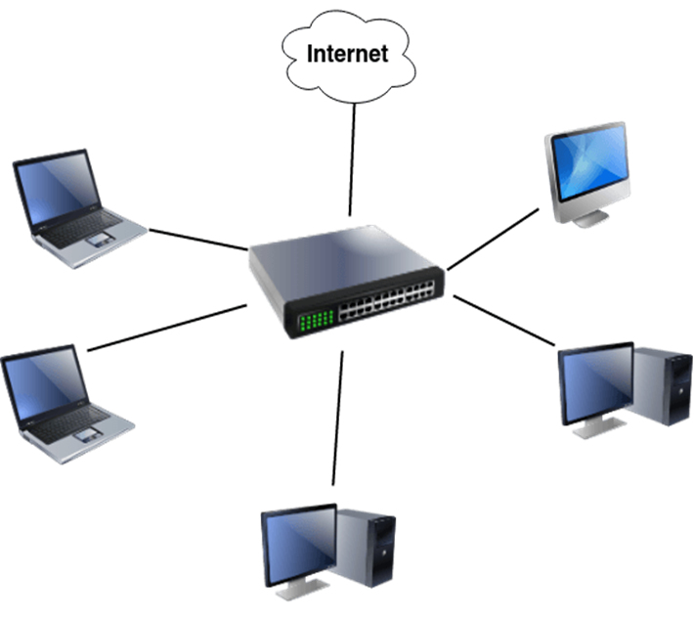
Network Topology
Star Advantages and Disadvantages
Advantages:
Network not affected if one PC fails
Network expansion and reconfiguration is simple
Network management and monitoring can be centralized
Troubleshooting is easy
Disadvantages
If the central device fails, all the network fails

Slide 26
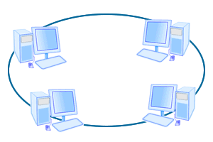
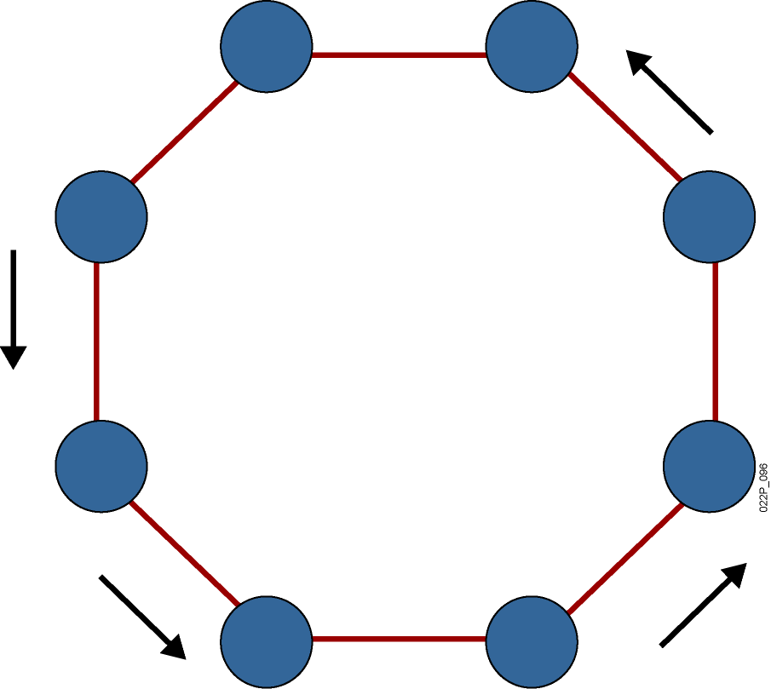
Network Topology
Ring Topology
A cable connects one node to another to form a ring (shape of a closed loop)
each device is connected directly to two other devices, one on either side of it.
All messages travel through a ring in the same direction
token is used to transmit data and pass over each station
Medium access control determines when station can insert frame

Slide 27
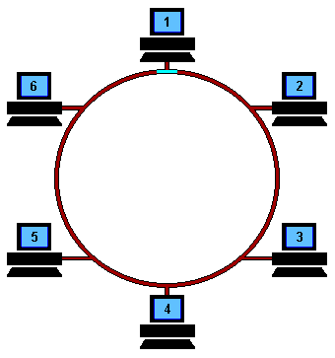
Network Topology
Frame Transmission - Ring LAN
Data transmitted in frames (token)
Circulate past all stations
Destination recognizes address and copies frame
Data is passed one way from device to device.
Frame circulates back to source where it is removed
Medium access control determines when station can insert frame

Slide 28
Network Topology
Dual Ring Topology
Signals travel in opposite directions.
More resilient than single ring.

Slide 29
Network Topology
Ring Advantages and Disadvantages
Advantages:
Fair (Equal access for all users)
Perform well under heavy traffic
Disadvantages
Network expansion or reconfiguration will affect the network operation
If one node fails, the entire network fails
Difficult to troubleshoot
very bad if we have about 60 pc, Slow Network

Slide 30
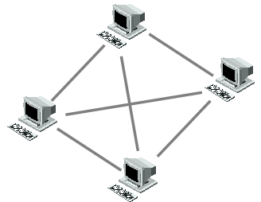
Network Topology
Mesh Topology
Each device/PC is connected to every other device/PC in the network by its own cable
Amount of cables needed can be calculated by:
CN = (D * (D-1)) / 2 (where CN is Cables Needed, and D is the amount of devices on the network)
Mesh Types:
Full Mesh
Partial Mesh

Slide 31
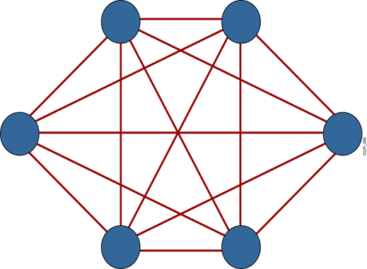
Network Topology
Mesh Advantages and Disadvantages
Advantages:
Mesh topology boasts the highest fault tolerance of all of the network topologies
Redundancy exist
Secure
Disadvantages
Because each connection needs its own cable a Mesh topology can get very expensive

Slide 32
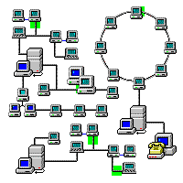
Network Topology
Hybrid Topology
Hybrid means that there is more than one topology exist
Combine bus ,star and ring topologies
Allow network expansion
Flexible

Slide 33
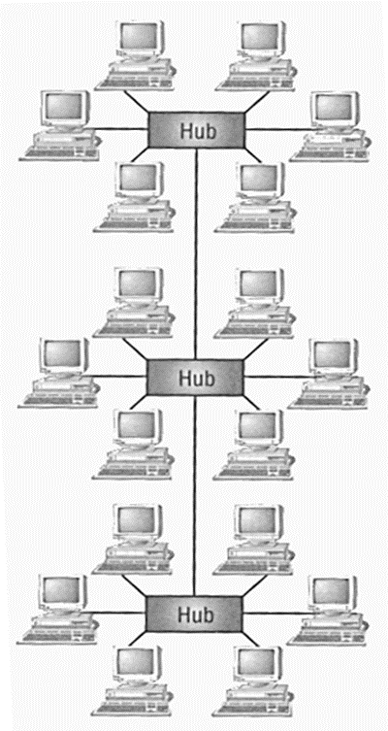
Network Topology
Hybrid Advantages and Disadvantages
Advantages:
Network expansion is simple
Disadvantages
If hub fails connections between failed hub and other hubs will fail

Slide 34
Networks Classifications
According to Network Model
- Peer to Peer Networks
– Client/Server Networks

Slide 35
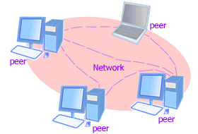
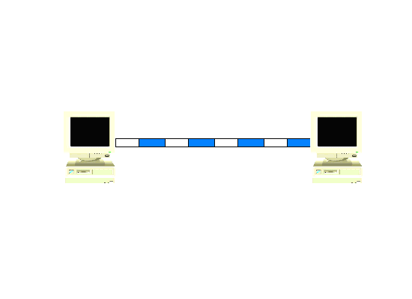
Network Model
Peer-to-Peer Networks
No dedicated resources to present specific service
Easy to work with
All nodes are the same (equal to use the resources )
Example : Windows Workgroup

Slide 36
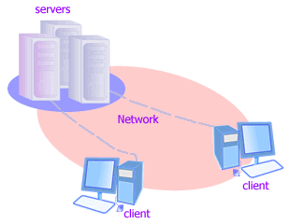
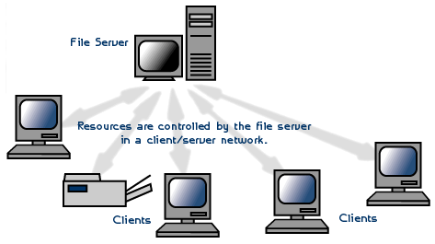
Network Model
Client/Server Networks
Some nodes (SERVER) are dedicated to present services to other nodes (CLIENTS)
Server is more powerful
Examples:
Mail Server
Web Server
File Server
Print Server

Slide 37
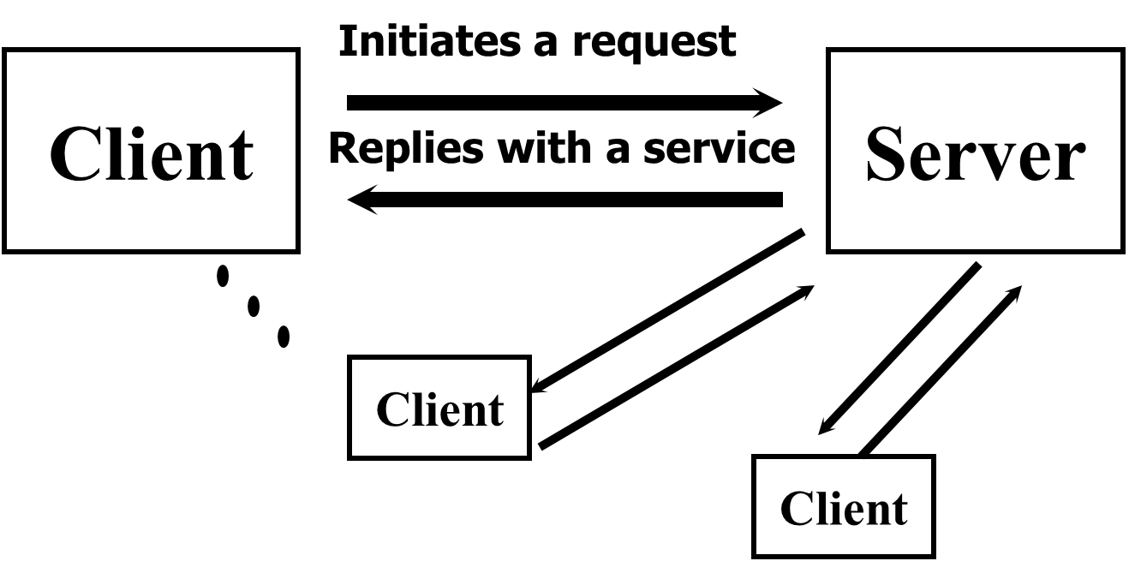
Network Model
Client/Server Networks
computers providing the service are called Servers
computers that request and use the service are called Client computers.
number of servers is very small compared with the number of clients

Slide 38
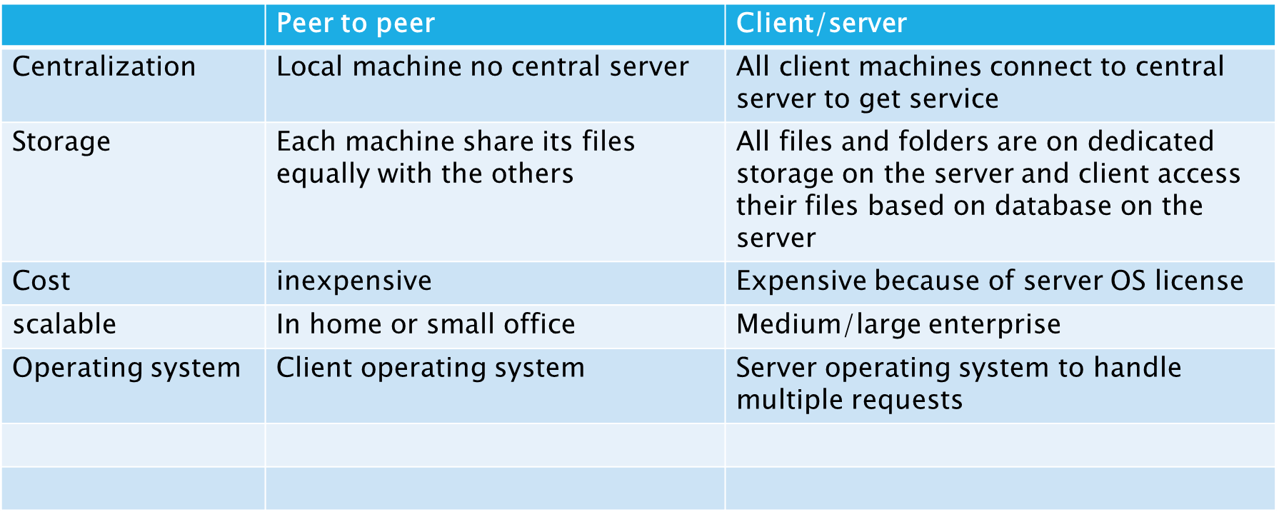
Peer to peer vs client/server model

Slide 39
Thank You

